Slide 1
Bellabeat Capstone Project
Gian Taparan, last updated Feb. 26, 2024

Slide 2
Table of contents
01
02
03
Business Task
Data Description
Data Documentation
04
05
06
Analysis Summary
Data Visualizations
Recommendations
Identifying Bellabeat’s needs
Where the data comes from and its credibility
Cleaning and manipulation of data
Key findings and trends in the data
Plots, charts, and other graphs
HIgh-level content recommendations

Slide 3
Business Task
How can trends in smart device usage apply to Bellabeat’s customers as well as influence their marketing strategy?
We have been tasked to analyze non-Bellabeat smart device data in order to gain insight into consumer usage of their personal devices.
We will apply these insights to one of Bellabeat’s products and help guide a marketing strategy for the company.
01

Slide 4
Data Description
Fitbit Fitness Tracker Data
Public Domain on Kaggle, made available through Möbius
contains submissions of personal tracker data from 30 Fitbit users
daily, hourly, and minute-level output for activity and sleep
information submitted comes from a one-month span (4/12/16-5/12/16)
Fitness Consumer Survey Data
Public Domain on Kaggle, made available through Harshita Aswani
contains answers to 21 questions involving fitness wearables (Fitbit, etc.) from 30 respondents
impact of wearables on fitness/exercise routines
responses taken in one-week span (3/30/23-4/7/23)
02

Slide 5
Data Documentation
Cleaning and manipulation of the data took place over the course of three days (2/19/24 - 2/21/24).
The tool used was BigQuery (Google SQL).
Five CSV files from the Fitbit Fitness Tracker Data and one CSV from the Fitness Consumer Survey Data datasets were uploaded to BigQuery for cleaning. From there, several smaller tables were created from the data files for easier usage and analysis.
For full documentation of cleaning queries and creation of smaller tables, see here.
03

Slide 6
Analysis Summary
1
2
3
Overall health is thought to improve
Sleep patterns are also thought to improve.
Tuesday, Wednesday, and Thursday
when utilizing fitness wearables, based on survey findings.
The same users agree that fitness wearables help with sleep patterns.
are the days where consumers burn the most calories and are the most active.
4
5
6
4:00-7:00 PM and 12:00 PM -3:00 PM
Saturday and Sunday
Under 18 to 34 years old
are the most active times throughout the week, regardless of day.
are the days where users spent the most time in nap-related sleep.
appear to be the age group most likely to use a fitness wearable.
04

Slide 7
Analysis Summary
Based on the initial analysis of the survey results, 80%+ of all respondents answered that their fitness wearable had a significant impact on various aspects of their overall health (exercise routines, positive diet changes, sleep patterns).
Using these results as a guideline for which data to analyze, I found that the middle of the week (Tuesday, Wednesday, Thursday) are the days in which the most calories are burned, as well as the most minutes are spent active.
On the other hand, users spent the majority of their overall napping time (here, we define a nap as any time a user slept and woke up on the same day) on Saturday and Sunday.
04

Slide 8
Analysis Summary
Additionally, 4:00 PM to 7:00 PM and 12:00 PM to 3:00 PM are the two general time periods throughout the week where the most calories are burned, as well as the most minutes are spent active.
This suggests a pattern that active fitness wearable users are more willing to dedicate free time to exercise during the midweek or even midday, as opposed to the weekends or at night.
This can further imply that the mid-week is the most optimal time for advertising campaigns or for creating promotions for prospective Bellabeat customers.
04

Slide 9
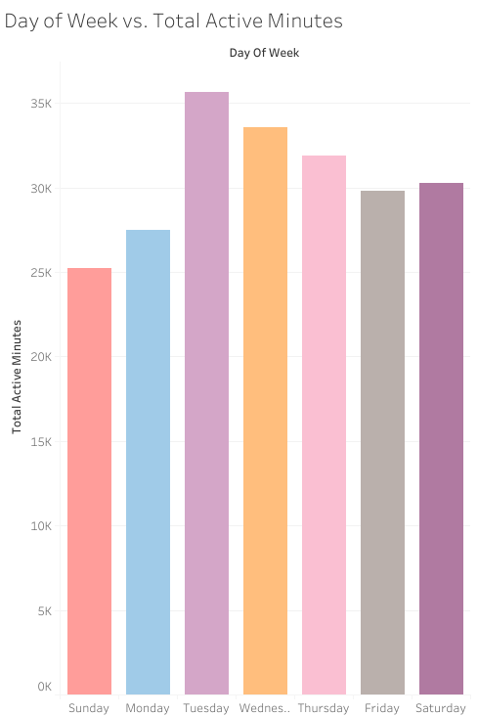
Data Visualizations
Day of Week vs. Total Active Minutes
across all users from the Fitbit Fitness Tracker Data dataset
Tuesday (35,664), Wednesday (33,560), and Thursday (31,868) had the most active minutes
Sunday (25,227) and Monday (27,500) had the least active minutes
05

Slide 10
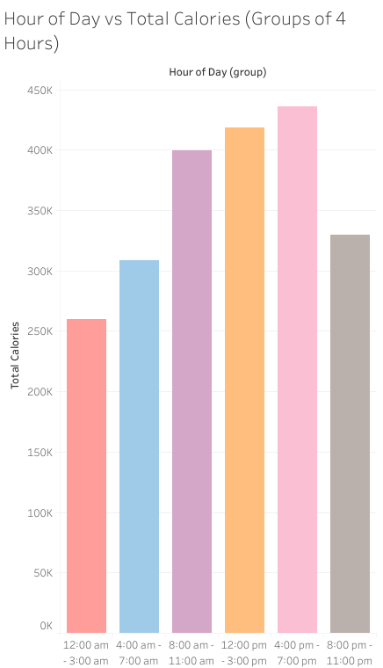
Hour of Day vs Total Calories (Groups of 4 Hours)
across all users from the Fitbit Fitness Tracker Data dataset
4:00 PM - 7:00 PM (435,951) and 12:00 PM - 3:00 PM (418,419) had the most total calories burned, regardless of the day of the week
05

Slide 11
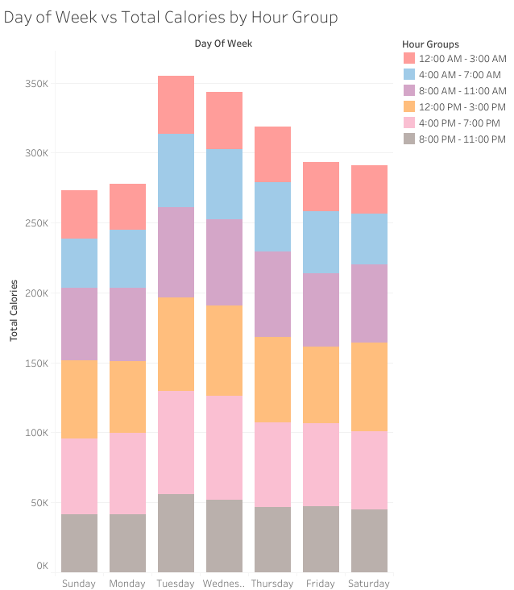
Day of Week vs. Total Calories by Hour Group
across all users from the Fitbit Fitness Tracker Data dataset
Wednesday (74,229) and Tuesday (73,725) at 4:00 PM - 7:00 PM had the most total calories burned
05

Slide 12
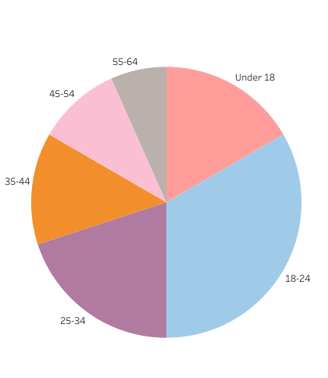
Age Group Count for Fitness Survey
across all respondents from the Fitness Consumer Survey Data dataset
Under 18 (5), 18-24 (10), and 25-34 (6) were the three age groups with the most respondents
of the 21 respondents in these age groups, 14 (66%) answered that fitness wearables influenced them to buy other fitness products
another 5 (24%) answered neutrally
05

Slide 13
Recommendations
After analysis of the data, I found a trend emerges in which fitness wearable users tend to be part of younger age groups and more active during the middle of the week, as well as in the afternoon/early evening.
I would recommend developing and introducing trial offers, promotions, and referral programs for the Bellabeat membership program targeting users that prefer to exercise during these times. For example, flexible subscription options based on usage of the membership during the week.
This can help broaden Bellabeat’s clientele by utilizing the existing community to incentivize non-Bellabeat customers to try out the product and eventually become regular customers.
06

